Slide 1
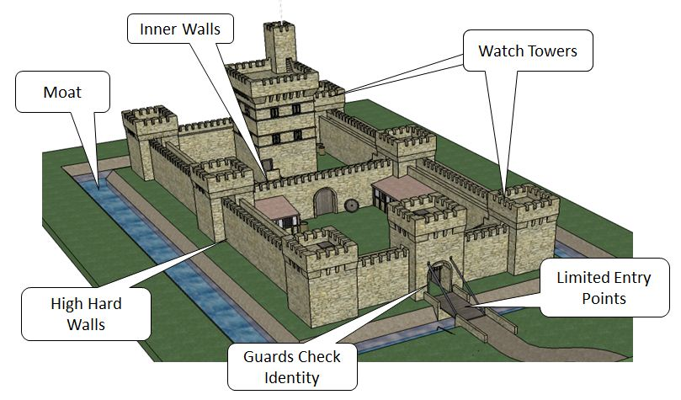
Defense in Depth
Policies & Procedures
Physical Security
Perimeter Network
Internal Network

